Slide 1

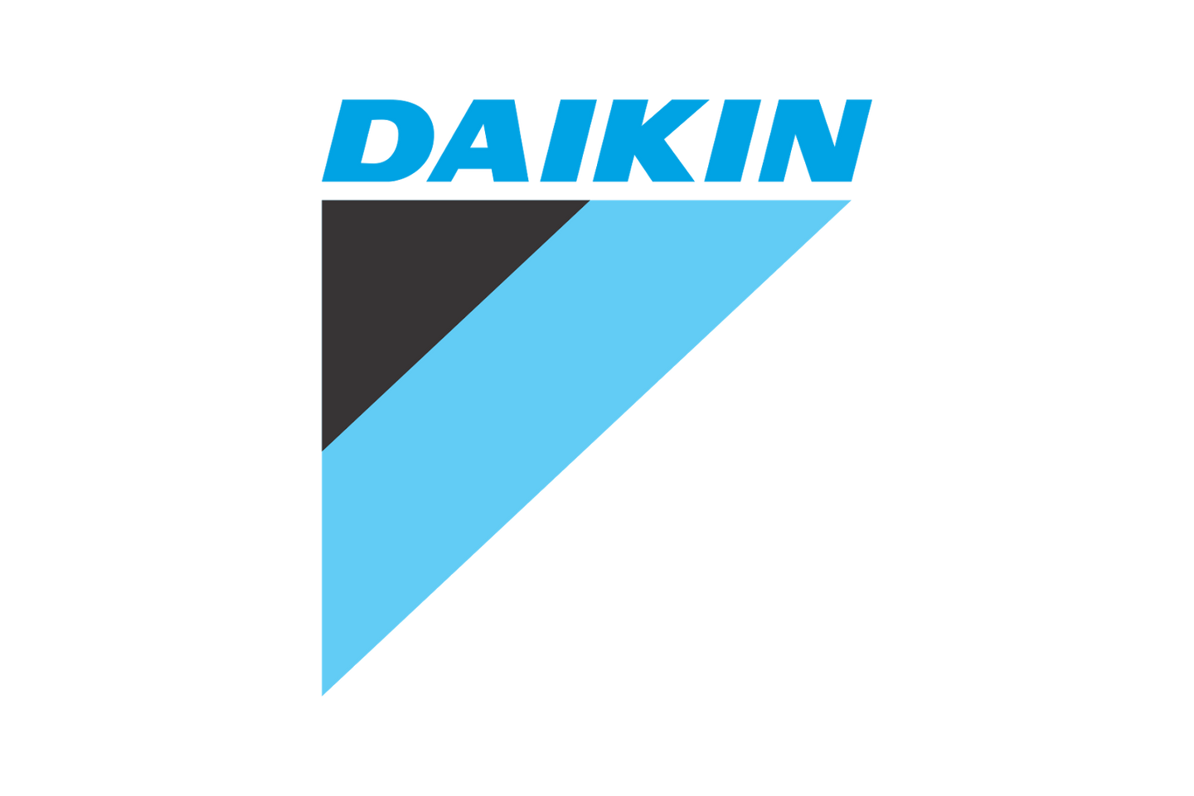
Project: Industrial Visit to Daikin Industries
Objective: Develop an Entity-Relationship Diagram (ERD) for Daikin Industries
Focus: Capturing essential business processes and visualizing data flow

Slide 2

Project Objectives
Objective: Gain insights into Daikin Industries' operational framework and data management strategies during the industrial visit
Task: Design a comprehensive ERD capturing data flow across order processing, inventory management, customer engagement, and supplier coordination
Purpose: Identify critical data relationships to enhance operational efficiency and streamline business processes.
Outcome: Develop a structured ERD that serves as a valuable tool for optimizing data management and decision-making.

Slide 3
Data and Analysis
The ERD comprises the following essential entities:
Employee: Stores employee data, including ID, name, and designation, enabling role-specific operations.
Customer: Maintains customer information such as ID, name, and contact details for seamless order processing and service coordination.
Order: Represents customer transactions, linked to order specifics and processing schedules.
Order Details: Contains detailed product information associated with each order, ensuring clarity and traceability.
Product: Holds information about available items, categorized and associated with suppliers for streamlined inventory management.
Supplier: Maintains supplier profiles, ensuring efficient procurement and supplier coordination.
Inventory: Monitors stock availability and levels, supporting effective warehouse management and order fulfillment.
ServiceRequest: Connects customers to products requiring maintenance or support, enhancing after-sales service quality.
The ERD models Daikin's business processes through relationships, including one-to-many (1:M) and many-to-many (M:N) associations, ensuring accurate representation of data flow and operational dynamics.

Slide 4
OBSERVATION
Streamlined Order Processing: Efficiently tracks the entire journey from order placement to fulfillment, ensuring smooth operations.
Efficient Inventory Management: Precise stock level monitoring minimizes inefficiencies and enhances warehouse management.
Improved Supplier Coordination: Clear supplier-product associations enable seamless procurement and inventory replenishment.
Robust Employee Management: Maps employee roles to relevant functions, promoting better role clarity and accountability.
Customer-Focused Service Management: Effectively links service requests to customers and products, enhancing after-sales support and satisfaction.

Slide 5
Insights and Recommendations
Automated Order Tracking: Implementing automated systems minimizes delays and errors, ensuring a smoother order processing experience.
Live Inventory Monitoring: Real-time stock updates prevent shortages and overstocking, enhancing inventory management efficiency.
Enhanced Supplier Collaboration: Strengthening partnerships with suppliers ensures timely procurement and improved supply chain coordination.
Data Accuracy and Reliability: Implementing validation rules boosts data integrity, enhancing overall system performance and efficiency.
Scalability for Growth: The ERD design is flexible, allowing seamless expansion across various departments to support future growth.

Slide 6
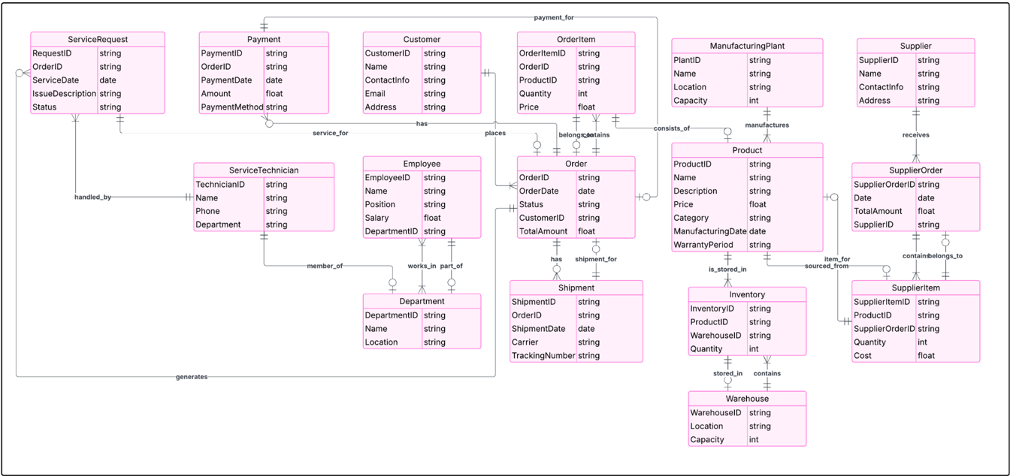
ENTITY RELATIONSHIP DIAGRAM (ERD)

